Slide 1
Fake News Research
Progress Report
Marian Longa, 21/08/2017

Slide 2
Progress during 07/08/2017 – 21/08/2017
Changed UTC to EST times
Added calculation of absolute and percentage difference in means: ∆µ, ∂µ
Implemented K-fold cross-validation
Semi-automated feature selection based on ∂µ and p-value
Implemented grid search of SVM hyperparameters with parallel processing

Slide 3
Methodology
Feature engineering and selection
Model performance evaluation

Slide 4
Feature engineering and selection

Slide 5
Feature selection method
Download 23 tweet fields from DB:
tweet_id, created_at, retweet_count, text, user_screen_name, user_verified, user_friends_count, user_followers_count, user_favourites_count, tweet_source, geo_coordinates, num_hashtags, num_mentions, num_urls, num_media, user_default_profile_image, user_description, user_listed_count, user_name, user_profile_use_background_image, user_default_profile, user_statuses_count, user_created_at
Define 84 base + derived features (check character types, calculate per-unit-time quantities, determine trends from histograms)
For each feature calculate difference in mean and p-value
Eliminate features with low percentage difference in mean and high p-value
Determine performances of different feature sets in logistic regression model

Slide 6
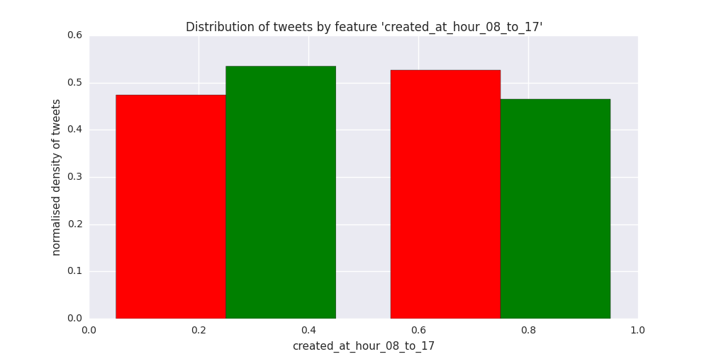
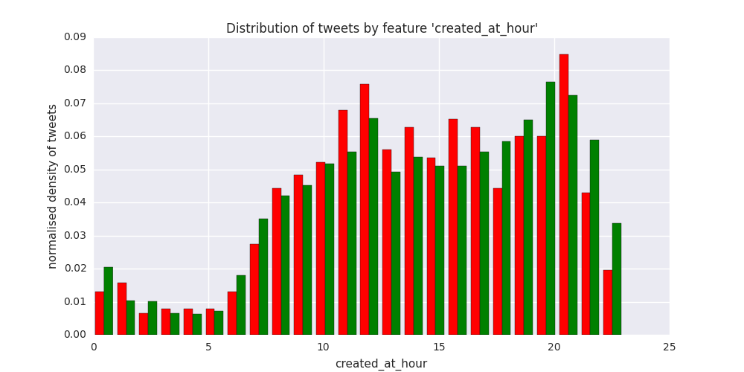
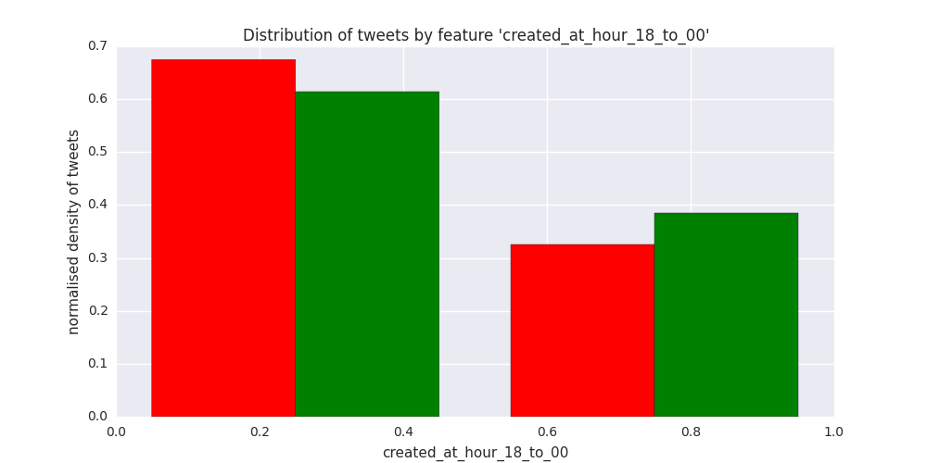
‘created_at_hour’ related features
∆µ = 0.0608 (12.9%), p = 0.00166
∆µ = -0.255 (-1.77%), p = 0.244
∆µ = -0.0607 (-16.1%), p = 0.00124

Slide 7
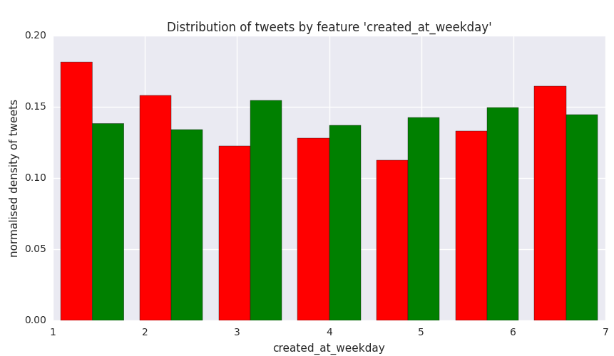
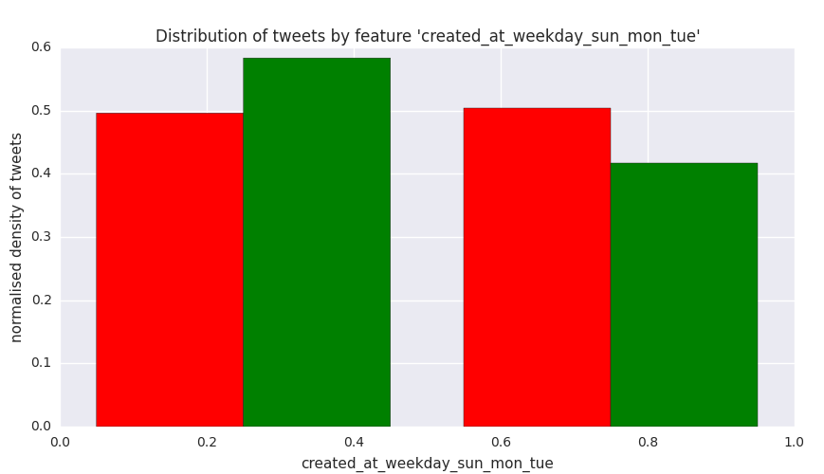
‘created_at_weekday’ related features
∆µ = 0.0872 (20.4%), p = 0.00000532
∆µ = -0.150 (-3.72%), p = 0.0549

Slide 8
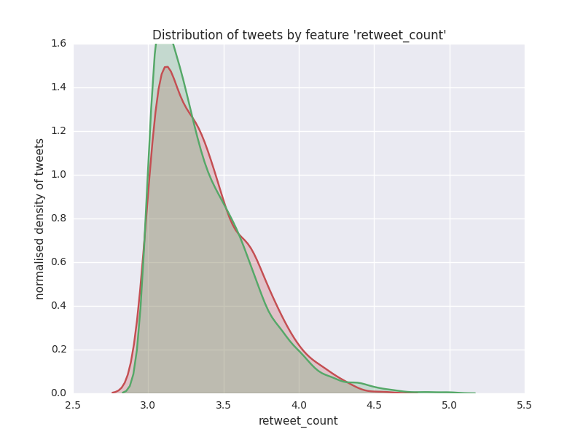
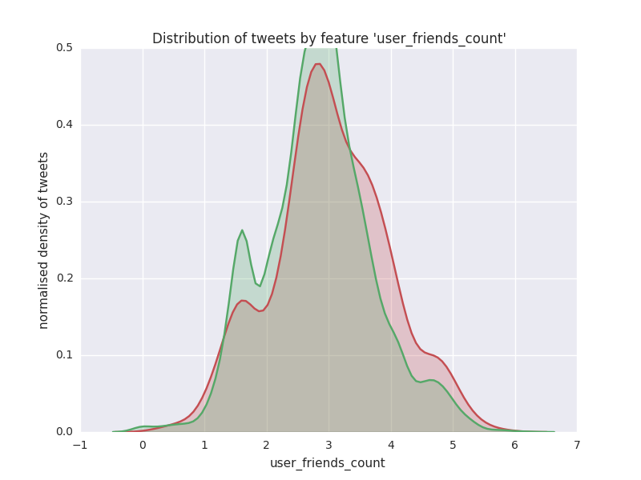
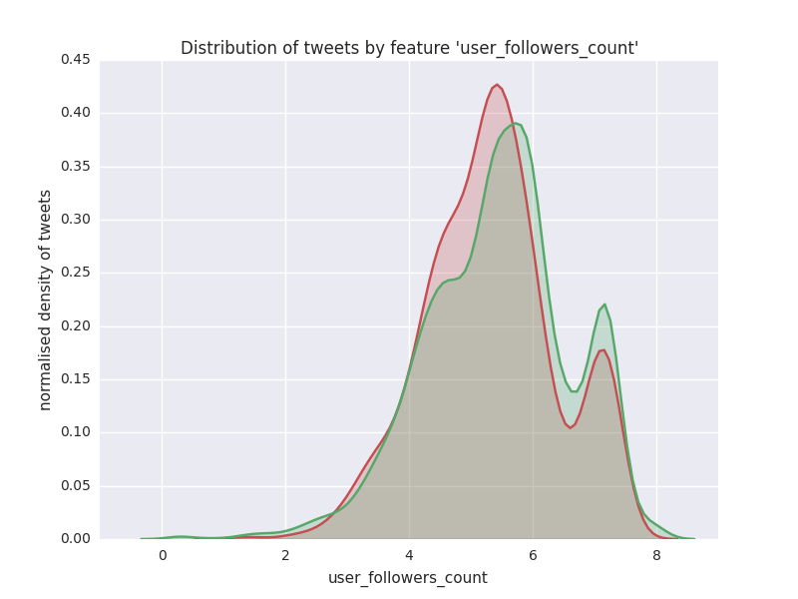
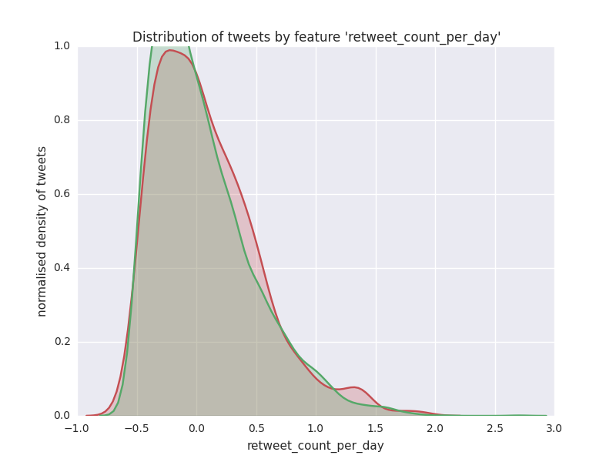
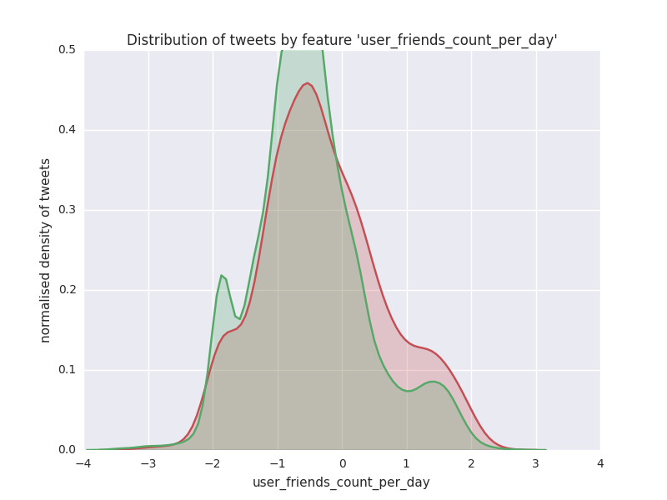
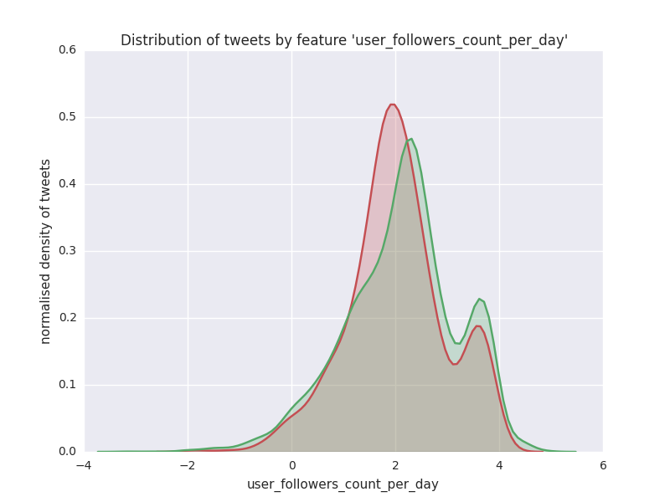
per-unit-time related features
∆µ = -121 (-3.61%), p = 0.523
∆µ = 2783 (43.4%), p = 0.0320
∆µ = -1091831 (-33.9%), p = 0.00111
∆µ = 0.218 (9.60%), p = 0.479
∆µ = 1.867 (51.6%), p = 0.000781
∆µ = -455 (-39.3%), p = 0.000277

Slide 9
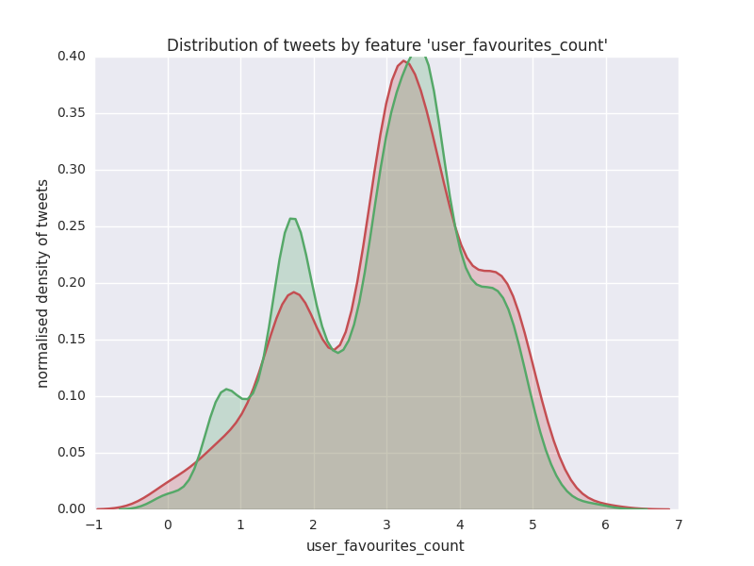
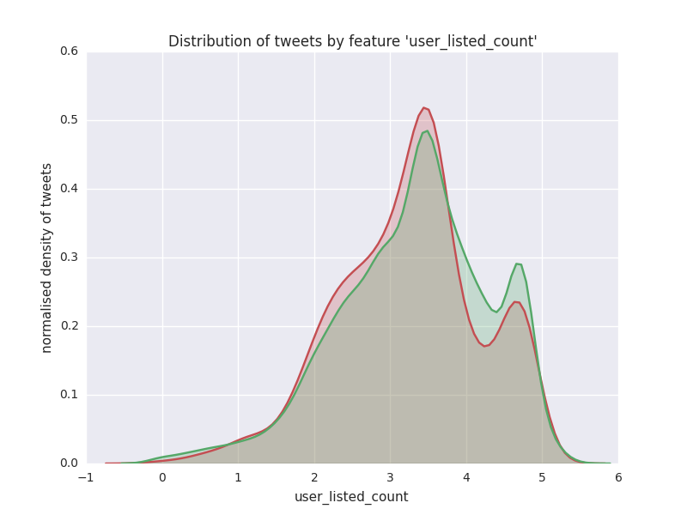
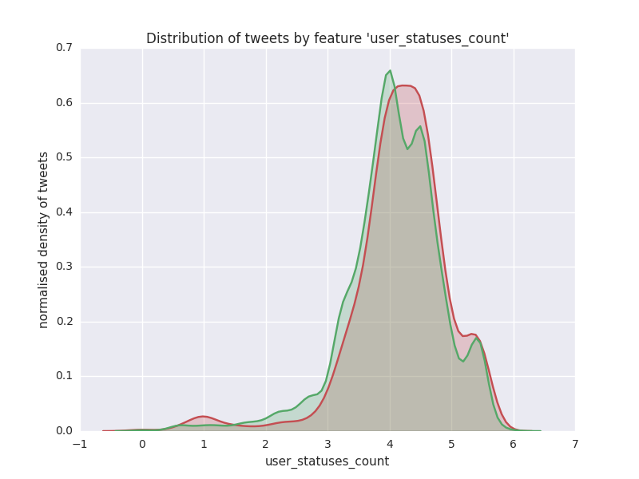
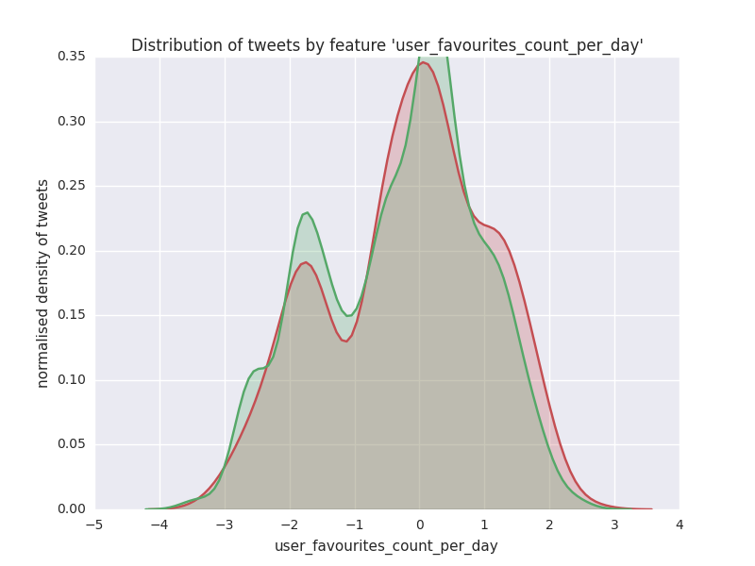
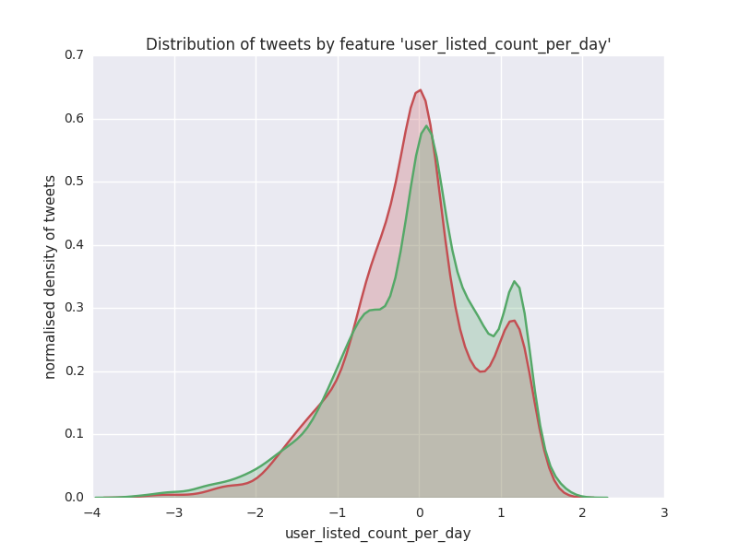
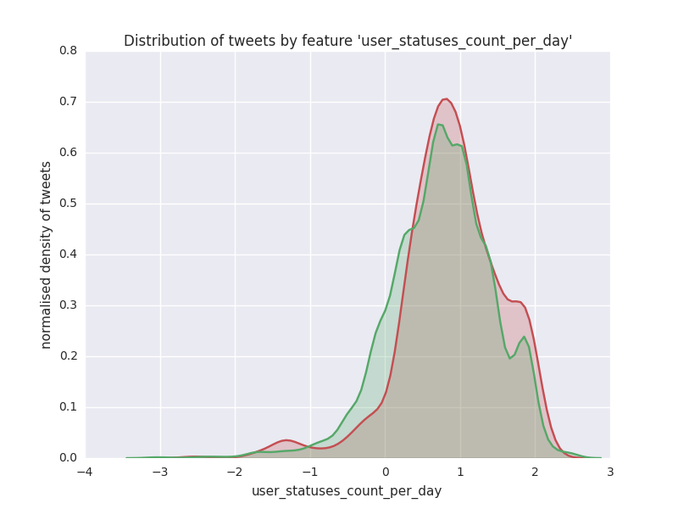
per-unit-time related features
∆µ = 2824 (24.3%), p = 0.0790
∆µ = -2092 (-18.2%), p = 0.0105
∆µ = 5588 (14.1%), p = 0.0476
∆µ = 2.11 (32.7%), p = 0.0106
∆µ = -0.873 (-22.1%), p = 0.000640
∆µ = 3.05 (19.5%), p = 0.00269

Slide 10
text-related features
FEATURE | DIFF MEAN VALUE | DIFF MEAN % | P VALUE
text_num_swears | -0.0186285911 | -81.9379969579 | 0.00282836836204724000
text_num_digits | 0.5833859464 | 31.5543431046 | 0.00000000000186958317
text_num_caps_digits | 2.9532653369 | 21.6607091782 | 0.00000000000000001817
text_num_caps_digits_exclam | 2.9462644041 | 21.1562753838 | 0.00000000000000011032
text_num_caps | 2.3698793905 | 20.1086465132 | 0.00000000000018982640
text_num_caps_exclam | 2.3628784577 | 19.5645167870 | 0.00000000000087281045
text_num_nonstandard | 0.6289052476 | 2.5750740054 | 0.10317168793059400000
text_num_exclam | -0.0070009328 | -2.3976465891 | 0.81441095787411000000
text_num_nonstandard_extended | 0.4740446145 | 2.2253878537 | 0.21011337294653800000
FEATURE | DIFF MEAN VALUE | DIFF MEAN % | P VALUE
user_screen_name_num_digits | 0.0926908225 | 60.5675951115 | 0.00058745594493451000
user_screen_name_has_digits | 0.0375779522 | 60.0228862580 | 0.00006165950921821620
user_screen_name_num_digits_underscores | 0.0838406252 | 33.2541483664 | 0.00430932407291493000
user_screen_name_num_weird_chars | 0.0838406252 | 33.2541483664 | 0.00430932407291493000
user_screen_name_num_caps_digits | 0.3621432325 | 18.5348403278 | 0.00000000588121100628
user_screen_name_num_caps_digits_underscores | 0.3532930351 | 17.2091665204 | 0.00000002262544180715
user_screen_name_num_caps | 0.2694524100 | 14.9628085947 | 0.00000439979639098320
user_screen_name_has_caps_digits | 0.1114833627 | 14.6050886847 | 0.00000000001178100595
user_screen_name_has_digits_underscores | 0.0217018733 | 14.3881711149 | 0.11751832452650200000
user_screen_name_has_weird_chars | 0.0217018733 | 14.3881711149 | 0.11751832452650200000
user_screen_name_num_caps_underscores | 0.2606022126 | 13.7166408382 | 0.00001346469570402120
user_screen_name_has_caps | 0.0913374786 | 12.4242579889 | 0.00000008838704498429
user_screen_name_has_caps_digits_underscores | 0.0888517656 | 11.1613876003 | 0.00000001201798678693
user_screen_name_has_underscores | -0.0083573317 | -9.0714756787 | 0.45574730213312400000
user_screen_name_num_underscores | -0.0088501973 | -8.9320313665 | 0.47699401643818400000
user_screen_name_has_caps_underscores | 0.0681208580 | 8.8651873927 | 0.00003033387736915430
FEATURE | DIFF MEAN VALUE | DIFF MEAN % | P VALUE
user_description_num_exclam | 0.0965375169 | 44.9086128124 | 0.00009675917875963300
user_description_num_caps_exclam | 1.3016032391 | 11.2664289884 | 0.00164608597263901000
user_description_num_caps | 1.2050657222 | 10.6285837349 | 0.00310965737703582000
user_description_num_digits | 0.1063647898 | 8.1629436369 | 0.30481632729323100000
user_description_num_caps_with_num_nonstandard | 2.3486072472 | 7.6253566060 | 0.00314724544039676000
user_description_num_non_a_to_z | 2.5675180140 | 7.3464850913 | 0.00299923689022873000
user_description_num_non_a_to_z_non_digits | 2.4611532242 | 7.3148657416 | 0.00311088476024148000
user_description_num_nonstandard | 1.1435415250 | 5.8757671569 | 0.02993281139725200000
user_description_num_nonstandard_extended | 0.6762967255 | 3.9082024257 | 0.16318955311498100000
FEATURE | DIFF MEAN VALUE | DIFF MEAN % | P VALUE
user_name_has_underscores | 0.0163215928 | 47.8604318562 | 0.02025241432449590000
user_name_has_digits_underscores | 0.0177355267 | 39.7464616332 | 0.02658832483519990000
user_name_num_digits | 0.0094311475 | 38.6022105919 | 0.35276549231467300000
user_name_has_nonprintable_chars | 0.0152925830 | 28.7052497134 | 0.07878999542386140000
user_name_num_nonprintable_chars | 0.0152925830 | 28.7052497134 | 0.07878999542386140000
user_name_has_weird_chars | 0.0281366215 | 28.6420116419 | 0.01466390719685070000
user_name_num_digits_underscores | 0.0304390374 | 25.7031069433 | 0.26080589854855000000
user_name_num_underscores | 0.0210078899 | 22.3502713379 | 0.38946950124127400000
user_name_has_digits | 0.0024648375 | 20.1774336204 | 0.56248580648111300000
user_name_num_weird_chars | 0.0859388684 | 20.1481181439 | 0.27114939598233300000
user_name_num_caps_digits_underscores | 0.0347943813 | 1.3228283788 | 0.58756178677826900000
user_name_num_caps_underscores | 0.0253632339 | 0.9733114156 | 0.68603906159413700000
user_name_has_caps_digits | 0.0081847269 | 0.8386783754 | 0.16826434210917800000
user_name_has_caps | 0.0070742516 | 0.7251415506 | 0.23690878845441900000
user_name_has_caps_underscores | 0.0057850617 | 0.5907337768 | 0.29427702016733700000
user_name_has_caps_digits_underscores | 0.0055900539 | 0.5707219405 | 0.30890613237491100000
user_name_num_caps_digits | 0.0137864914 | 0.5435653245 | 0.81613728320399300000
user_name_num_caps | 0.0043553439 | 0.1733900514 | 0.94020082866916800000

Slide 11
All Features (sorted by ∂µ)
FEATURE | DIFF MEAN VALUE | DIFF MEAN PERCENTAGE | P VALUE | T VALUE
text_num_swears | -0.0186285911 | -0.8193799696 | 0.00282836836204724000 | -2.9870573873
user_screen_name_num_digits | 0.0926908225 | 0.6056759511 | 0.00058745594493451000 | 3.4392108030
user_screen_name_has_digits | 0.0375779522 | 0.6002288626 | 0.00006165950921821620 | 4.0092685779
user_friends_count_per_day | 1.8669972610 | 0.5158126068 | 0.00078128718343608400 | 3.3610925000
user_name_has_underscores | 0.0163215928 | 0.4786043186 | 0.02025241432449590000 | 2.3222680319
user_description_num_exclam | 0.0965375169 | 0.4490861281 | 0.00009675917875963300 | 3.9012593731
user_friends_count | 2782.9841722912 | 0.4342144438 | 0.03204874419941490000 | 2.1443112677
user_name_has_digits_underscores | 0.0177355267 | 0.3974646163 | 0.02658832483519990000 | 2.2180659539
user_followers_count_per_day | -454.9451879020 | -0.3933589371 | 0.00027676555361775100 | -3.6383245093
user_name_num_digits | 0.0094311475 | 0.3860221059 | 0.35276549231467300000 | 0.9293119924
user_followers_count | -1091831.0212858900 | -0.3386639382 | 0.00111016076037016000 | -3.2626206240
user_screen_name_num_digits_underscores | 0.0838406252 | 0.3325414837 | 0.00430932407291493000 | 2.8556924449
user_screen_name_num_weird_chars | 0.0838406252 | 0.3325414837 | 0.00430932407291493000 | 2.8556924449
user_favourites_count_per_day | 2.1091691343 | 0.3267733611 | 0.01064188111794010000 | 2.5550591773
num_media | -0.0435289996 | -0.3175246583 | 0.00113783067671653000 | -3.2556237564
text_num_digits | 0.5833859464 | 0.3155434310 | 0.00000000000186958317 | 7.0590362967
num_media_is_nonzero | -0.0429439762 | -0.3144245913 | 0.00124180263026521000 | -3.2306668037
user_name_has_nonprintable_chars | 0.0152925830 | 0.2870524971 | 0.07878999542386140000 | 1.7580554274
user_name_num_nonprintable_chars | 0.0152925830 | 0.2870524971 | 0.07878999542386140000 | 1.7580554274
user_name_has_weird_chars | 0.0281366215 | 0.2864201164 | 0.01466390719685070000 | 2.4412954096
num_mentions_is_more_than_2 | 0.0092687258 | 0.2860202623 | 0.17666424979961600000 | 1.3512593484
user_name_num_digits_underscores | 0.0304390374 | 0.2570310694 | 0.26080589854855000000 | 1.1245964314
num_urls | 0.0951363120 | 0.2507752338 | 0.00000063457724714638 | 4.9858436883
num_urls_is_nonzero | 0.0938145359 | 0.2499741747 | 0.00000055546626709528 | 5.0116315221
user_favourites_count | 2824.1842660782 | 0.2428288211 | 0.07899865235454700000 | 1.7568304406
user_name_num_underscores | 0.0210078899 | 0.2235027134 | 0.38946950124127400000 | 0.8606433875
user_listed_count_per_day | -0.8728037332 | -0.2210862031 | 0.00064001005212550900 | -3.4159004947
text_num_caps_digits | 2.9532653369 | 0.2166070918 | 0.00000000000000001817 | 8.5314381342
text_num_caps_digits_exclam | 2.9462644041 | 0.2115627538 | 0.00000000000000011032 | 8.3177318620
user_default_profile_image | 0.0009317605 | 0.2112229398 | 0.71668622458125300000 | 0.3629085404
created_at_weekday_sun_mon_tue | 0.0871847798 | 0.2036730449 | 0.00000531821008238821 | 4.5560249682
user_name_has_digits | 0.0024648375 | 0.2017743362 | 0.56248580648111300000 | 0.5791860169
user_name_num_weird_chars | 0.0859388684 | 0.2014811814 | 0.27114939598233300000 | 1.1005227179
text_num_caps | 2.3698793905 | 0.2010864651 | 0.00000000000018982640 | 7.3730060331
text_num_caps_exclam | 2.3628784577 | 0.1956451679 | 0.00000000000087281045 | 7.1650437647
user_verified | -0.1458266294 | -0.1955636300 | 0.00000000000000000430 | -8.6985564931
user_statuses_count_per_day | 3.0545859748 | 0.1947141566 | 0.00268756974226067000 | 3.0026572861
user_screen_name_num_caps_digits | 0.3621432325 | 0.1853484033 | 0.00000000588121100628 | 5.8287238938
user_listed_count | -2091.5358936551 | -0.1821802326 | 0.01054790630598750000 | -2.5581485180
user_screen_name_num_caps_digits_underscores | 0.3532930351 | 0.1720916652 | 0.00000002262544180715 | 5.5982848331
user_default_profile | 0.0317995096 | 0.1636911000 | 0.03799576178479910000 | 2.0753676198
created_at_hour_18_to_00 | -0.0606601549 | -0.1605437597 | 0.00123535800778445000 | -3.2321565395
user_screen_name_num_caps | 0.2694524100 | 0.1496280859 | 0.00000439979639098320 | 4.5958492546
user_screen_name_has_caps_digits | 0.1114833627 | 0.1460508868 | 0.00000000001178100595 | 6.7964237321
user_screen_name_has_digits_underscores | 0.0217018733 | 0.1438817111 | 0.11751832452650200000 | 1.5655046754
user_screen_name_has_weird_chars | 0.0217018733 | 0.1438817111 | 0.11751832452650200000 | 1.5655046754
user_statuses_count | 5587.9236888144 | 0.1405591218 | 0.04760632681384600000 | 1.9812797141
user_screen_name_num_caps_underscores | 0.2606022126 | 0.1371664084 | 0.00001346469570402120 | 4.3560993798
created_at_hour_08_to_17 | 0.0608210490 | 0.1285332603 | 0.00165832748771026000 | 3.1469024005
user_screen_name_has_caps | 0.0913374786 | 0.1242425799 | 0.00000008838704498429 | 5.3558399964
user_description_num_caps_exclam | 1.3016032391 | 0.1126642899 | 0.00164608597263901000 | 3.1490719063
user_screen_name_has_caps_digits_underscores | 0.0888517656 | 0.1116138760 | 0.00000001201798678693 | 5.7075782391
user_description_num_caps | 1.2050657222 | 0.1062858373 | 0.00310965737703582000 | 2.9579075166
retweet_count_per_day | 0.2180610230 | 0.0959727846 | 0.47923622614839400000 | 0.7075765814
user_screen_name_has_underscores | -0.0083573317 | -0.0907147568 | 0.45574730213312400000 | -0.7459170171
user_screen_name_num_underscores | -0.0088501973 | -0.0893203137 | 0.47699401643818400000 | -0.7111910345
user_screen_name_has_caps_underscores | 0.0681208580 | 0.0886518739 | 0.00003033387736915430 | 4.1742032434
user_description_num_digits | 0.1063647898 | 0.0816294364 | 0.30481632729323100000 | 1.0262490677
user_description_num_caps_with_num_nonstandard | 2.3486072472 | 0.0762535661 | 0.00314724544039676000 | 2.9541962017
user_description_num_non_a_to_z | 2.5675180140 | 0.0734648509 | 0.00299923689022873000 | 2.9690516710
user_description_num_non_a_to_z_non_digits | 2.4611532242 | 0.0731486574 | 0.00311088476024148000 | 2.9577856845
num_hashtags_is_nonzero | 0.0166382896 | 0.0625022808 | 0.33121019136142100000 | 0.9717593143
user_profile_use_background_image | 0.0472168365 | 0.0619812993 | 0.00421215183874502000 | 2.8629369842
geo_coordinates | 0.0250903248 | 0.0603847996 | 0.45186097138484300000 | 0.7523661185
num_hashtags | 0.0250903248 | 0.0603847996 | 0.45186097138484300000 | 0.7523661185
user_description_num_nonstandard | 1.1435415250 | 0.0587576716 | 0.02993281139725200000 | 2.1715047108
created_at_hour_of_week | -3.8447462964 | -0.0442520322 | 0.04027251939954340000 | -2.0513959479
user_description_num_nonstandard_extended | 0.6762967255 | 0.0390820243 | 0.16318955311498100000 | 1.3945984031
created_at_weekday | -0.1495776019 | -0.0372160237 | 0.05489567292437260000 | -1.9200827451
retweet_count | -121.1012823672 | -0.0360786100 | 0.52299328861292000000 | -0.6387763135
user_created_at_delta | -73.4627428178 | -0.0304142890 | 0.04353423148663660000 | -2.0189826080
text_num_nonstandard | 0.6289052476 | 0.0257507401 | 0.10317168793059400000 | 1.6299208118
num_mentions | 0.0553531932 | 0.0243525954 | 0.09427154344597160000 | 1.6735531023
text_num_exclam | -0.0070009328 | -0.0239764659 | 0.81441095787411000000 | -0.2347499702
text_num_nonstandard_extended | 0.4740446145 | 0.0222538785 | 0.21011337294653800000 | 1.2533904658
created_at_hour | -0.2548838507 | -0.0176722828 | 0.24395385387751300000 | -1.1652775057
user_name_num_caps_digits_underscores | 0.0347943813 | 0.0132282838 | 0.58756178677826900000 | 0.5424024778
user_name_num_caps_underscores | 0.0253632339 | 0.0097331142 | 0.68603906159413700000 | 0.4042561208
user_name_has_caps_digits | 0.0081847269 | 0.0083867838 | 0.16826434210917800000 | 1.3779717396
user_name_has_caps | 0.0070742516 | 0.0072514155 | 0.23690878845441900000 | 1.1828690209
user_name_has_caps_underscores | 0.0057850617 | 0.0059073378 | 0.29427702016733700000 | 1.0488785928
user_name_has_caps_digits_underscores | 0.0055900539 | 0.0057072194 | 0.30890613237491100000 | 1.0176078613
user_name_num_caps_digits | 0.0137864914 | 0.0054356532 | 0.81613728320399300000 | 0.2325263715
tweet_id | 3618336130302460.0000000000 | 0.0045990921 | 0.10362794925576900000 | 1.6277661453
user_name_num_caps | 0.0043553439 | 0.0017339005 | 0.94020082866916800000 | 0.0750206501
FEATURE | DIFF MEAN VALUE | DIFF MEAN PERCENTAGE | P VALUE | T VALUE
user_verified | -0.1458266294 | -0.1955636300 | 0.00000000000000000430 | -8.6985564931
text_num_caps_digits | 2.9532653369 | 0.2166070918 | 0.00000000000000001817 | 8.5314381342
text_num_caps_digits_exclam | 2.9462644041 | 0.2115627538 | 0.00000000000000011032 | 8.3177318620
text_num_caps | 2.3698793905 | 0.2010864651 | 0.00000000000018982640 | 7.3730060331
text_num_caps_exclam | 2.3628784577 | 0.1956451679 | 0.00000000000087281045 | 7.1650437647
text_num_digits | 0.5833859464 | 0.3155434310 | 0.00000000000186958317 | 7.0590362967
user_screen_name_has_caps_digits | 0.1114833627 | 0.1460508868 | 0.00000000001178100595 | 6.7964237321
user_screen_name_num_caps_digits | 0.3621432325 | 0.1853484033 | 0.00000000588121100628 | 5.8287238938
user_screen_name_has_caps_digits_underscores | 0.0888517656 | 0.1116138760 | 0.00000001201798678693 | 5.7075782391
user_screen_name_num_caps_digits_underscores | 0.3532930351 | 0.1720916652 | 0.00000002262544180715 | 5.5982848331
user_screen_name_has_caps | 0.0913374786 | 0.1242425799 | 0.00000008838704498429 | 5.3558399964
num_urls_is_nonzero | 0.0938145359 | 0.2499741747 | 0.00000055546626709528 | 5.0116315221
num_urls | 0.0951363120 | 0.2507752338 | 0.00000063457724714638 | 4.9858436883
user_screen_name_num_caps | 0.2694524100 | 0.1496280859 | 0.00000439979639098320 | 4.5958492546
created_at_weekday_sun_mon_tue | 0.0871847798 | 0.2036730449 | 0.00000531821008238821 | 4.5560249682
user_screen_name_num_caps_underscores | 0.2606022126 | 0.1371664084 | 0.00001346469570402120 | 4.3560993798
user_screen_name_has_caps_underscores | 0.0681208580 | 0.0886518739 | 0.00003033387736915430 | 4.1742032434
user_screen_name_has_digits | 0.0375779522 | 0.6002288626 | 0.00006165950921821620 | 4.0092685779
user_description_num_exclam | 0.0965375169 | 0.4490861281 | 0.00009675917875963300 | 3.9012593731
user_followers_count_per_day | -454.9451879020 | -0.3933589371 | 0.00027676555361775100 | -3.6383245093
user_screen_name_num_digits | 0.0926908225 | 0.6056759511 | 0.00058745594493451000 | 3.4392108030
user_listed_count_per_day | -0.8728037332 | -0.2210862031 | 0.00064001005212550900 | -3.4159004947
user_friends_count_per_day | 1.8669972610 | 0.5158126068 | 0.00078128718343608400 | 3.3610925000
user_followers_count | -1091831.0212858900 | -0.3386639382 | 0.00111016076037016000 | -3.2626206240
num_media | -0.0435289996 | -0.3175246583 | 0.00113783067671653000 | -3.2556237564
created_at_hour_18_to_00 | -0.0606601549 | -0.1605437597 | 0.00123535800778445000 | -3.2321565395
num_media_is_nonzero | -0.0429439762 | -0.3144245913 | 0.00124180263026521000 | -3.2306668037
user_description_num_caps_exclam | 1.3016032391 | 0.1126642899 | 0.00164608597263901000 | 3.1490719063
created_at_hour_08_to_17 | 0.0608210490 | 0.1285332603 | 0.00165832748771026000 | 3.1469024005
user_statuses_count_per_day | 3.0545859748 | 0.1947141566 | 0.00268756974226067000 | 3.0026572861
text_num_swears | -0.0186285911 | -0.8193799696 | 0.00282836836204724000 | -2.9870573873
user_description_num_non_a_to_z | 2.5675180140 | 0.0734648509 | 0.00299923689022873000 | 2.9690516710
user_description_num_caps | 1.2050657222 | 0.1062858373 | 0.00310965737703582000 | 2.9579075166
user_description_num_non_a_to_z_non_digits | 2.4611532242 | 0.0731486574 | 0.00311088476024148000 | 2.9577856845
user_description_num_caps_with_num_nonstandard | 2.3486072472 | 0.0762535661 | 0.00314724544039676000 | 2.9541962017
user_profile_use_background_image | 0.0472168365 | 0.0619812993 | 0.00421215183874502000 | 2.8629369842
user_screen_name_num_digits_underscores | 0.0838406252 | 0.3325414837 | 0.00430932407291493000 | 2.8556924449
user_screen_name_num_weird_chars | 0.0838406252 | 0.3325414837 | 0.00430932407291493000 | 2.8556924449
user_listed_count | -2091.5358936551 | -0.1821802326 | 0.01054790630598750000 | -2.5581485180
user_favourites_count_per_day | 2.1091691343 | 0.3267733611 | 0.01064188111794010000 | 2.5550591773
user_name_has_weird_chars | 0.0281366215 | 0.2864201164 | 0.01466390719685070000 | 2.4412954096
user_name_has_underscores | 0.0163215928 | 0.4786043186 | 0.02025241432449590000 | 2.3222680319
user_name_has_digits_underscores | 0.0177355267 | 0.3974646163 | 0.02658832483519990000 | 2.2180659539
user_description_num_nonstandard | 1.1435415250 | 0.0587576716 | 0.02993281139725200000 | 2.1715047108
user_friends_count | 2782.9841722912 | 0.4342144438 | 0.03204874419941490000 | 2.1443112677
user_default_profile | 0.0317995096 | 0.1636911000 | 0.03799576178479910000 | 2.0753676198
created_at_hour_of_week | -3.8447462964 | -0.0442520322 | 0.04027251939954340000 | -2.0513959479
user_created_at_delta | -73.4627428178 | -0.0304142890 | 0.04353423148663660000 | -2.0189826080
user_statuses_count | 5587.9236888144 | 0.1405591218 | 0.04760632681384600000 | 1.9812797141
created_at_weekday | -0.1495776019 | -0.0372160237 | 0.05489567292437260000 | -1.9200827451
user_name_has_nonprintable_chars | 0.0152925830 | 0.2870524971 | 0.07878999542386140000 | 1.7580554274
user_name_num_nonprintable_chars | 0.0152925830 | 0.2870524971 | 0.07878999542386140000 | 1.7580554274
user_favourites_count | 2824.1842660782 | 0.2428288211 | 0.07899865235454700000 | 1.7568304406
num_mentions | 0.0553531932 | 0.0243525954 | 0.09427154344597160000 | 1.6735531023
text_num_nonstandard | 0.6289052476 | 0.0257507401 | 0.10317168793059400000 | 1.6299208118
tweet_id | 3618336130302460.0000000000 | 0.0045990921 | 0.10362794925576900000 | 1.6277661453
user_screen_name_has_digits_underscores | 0.0217018733 | 0.1438817111 | 0.11751832452650200000 | 1.5655046754
user_screen_name_has_weird_chars | 0.0217018733 | 0.1438817111 | 0.11751832452650200000 | 1.5655046754
user_description_num_nonstandard_extended | 0.6762967255 | 0.0390820243 | 0.16318955311498100000 | 1.3945984031
user_name_has_caps_digits | 0.0081847269 | 0.0083867838 | 0.16826434210917800000 | 1.3779717396
num_mentions_is_more_than_2 | 0.0092687258 | 0.2860202623 | 0.17666424979961600000 | 1.3512593484
text_num_nonstandard_extended | 0.4740446145 | 0.0222538785 | 0.21011337294653800000 | 1.2533904658
user_name_has_caps | 0.0070742516 | 0.0072514155 | 0.23690878845441900000 | 1.1828690209
created_at_hour | -0.2548838507 | -0.0176722828 | 0.24395385387751300000 | -1.1652775057
user_name_num_digits_underscores | 0.0304390374 | 0.2570310694 | 0.26080589854855000000 | 1.1245964314
user_name_num_weird_chars | 0.0859388684 | 0.2014811814 | 0.27114939598233300000 | 1.1005227179
user_name_has_caps_underscores | 0.0057850617 | 0.0059073378 | 0.29427702016733700000 | 1.0488785928
user_description_num_digits | 0.1063647898 | 0.0816294364 | 0.30481632729323100000 | 1.0262490677
user_name_has_caps_digits_underscores | 0.0055900539 | 0.0057072194 | 0.30890613237491100000 | 1.0176078613
num_hashtags_is_nonzero | 0.0166382896 | 0.0625022808 | 0.33121019136142100000 | 0.9717593143
user_name_num_digits | 0.0094311475 | 0.3860221059 | 0.35276549231467300000 | 0.9293119924
user_name_num_underscores | 0.0210078899 | 0.2235027134 | 0.38946950124127400000 | 0.8606433875
geo_coordinates | 0.0250903248 | 0.0603847996 | 0.45186097138484300000 | 0.7523661185
num_hashtags | 0.0250903248 | 0.0603847996 | 0.45186097138484300000 | 0.7523661185
user_screen_name_has_underscores | -0.0083573317 | -0.0907147568 | 0.45574730213312400000 | -0.7459170171
user_screen_name_num_underscores | -0.0088501973 | -0.0893203137 | 0.47699401643818400000 | -0.7111910345
retweet_count_per_day | 0.2180610230 | 0.0959727846 | 0.47923622614839400000 | 0.7075765814
retweet_count | -121.1012823672 | -0.0360786100 | 0.52299328861292000000 | -0.6387763135
user_name_has_digits | 0.0024648375 | 0.2017743362 | 0.56248580648111300000 | 0.5791860169
user_name_num_caps_digits_underscores | 0.0347943813 | 0.0132282838 | 0.58756178677826900000 | 0.5424024778
user_name_num_caps_underscores | 0.0253632339 | 0.0097331142 | 0.68603906159413700000 | 0.4042561208
user_default_profile_image | 0.0009317605 | 0.2112229398 | 0.71668622458125300000 | 0.3629085404
text_num_exclam | -0.0070009328 | -0.0239764659 | 0.81441095787411000000 | -0.2347499702
user_name_num_caps_digits | 0.0137864914 | 0.0054356532 | 0.81613728320399300000 | 0.2325263715
user_name_num_caps | 0.0043553439 | 0.0017339005 | 0.94020082866916800000 | 0.0750206501
NB: DIFF_MEAN_PERCENTAGE
is on a scale 0 to 1
p < 0.01
All Features (sorted by p-value)
0.01 ≤ p < 0.05
p ≥ 0.05

Slide 12
FEATURE | DIFF MEAN VALUE | DIFF MEAN PERCENTAGE | P VALUE | T VALUE
text_num_swears | -0.0186285911 | -0.8193799696 | 0.00282836836204724000 | -2.9870573873
user_screen_name_num_digits | 0.0926908225 | 0.6056759511 | 0.00058745594493451000 | 3.4392108030
user_screen_name_has_digits | 0.0375779522 | 0.6002288626 | 0.00006165950921821620 | 4.0092685779
user_friends_count_per_day | 1.8669972610 | 0.5158126068 | 0.00078128718343608400 | 3.3610925000
user_description_num_exclam | 0.0965375169 | 0.4490861281 | 0.00009675917875963300 | 3.9012593731
user_followers_count_per_day | -454.9451879020 | -0.3933589371 | 0.00027676555361775100 | -3.6383245093
user_followers_count | -1091831.0212858900 | -0.3386639382 | 0.00111016076037016000 | -3.2626206240
user_screen_name_num_digits_underscores | 0.0838406252 | 0.3325414837 | 0.00430932407291493000 | 2.8556924449
user_screen_name_num_weird_chars | 0.0838406252 | 0.3325414837 | 0.00430932407291493000 | 2.8556924449
num_media | -0.0435289996 | -0.3175246583 | 0.00113783067671653000 | -3.2556237564
text_num_digits | 0.5833859464 | 0.3155434310 | 0.00000000000186958317 | 7.0590362967
num_media_is_nonzero | -0.0429439762 | -0.3144245913 | 0.00124180263026521000 | -3.2306668037
num_urls | 0.0951363120 | 0.2507752338 | 0.00000063457724714638 | 4.9858436883
num_urls_is_nonzero | 0.0938145359 | 0.2499741747 | 0.00000055546626709528 | 5.0116315221
user_listed_count_per_day | -0.8728037332 | -0.2210862031 | 0.00064001005212550900 | -3.4159004947
text_num_caps_digits | 2.9532653369 | 0.2166070918 | 0.00000000000000001817 | 8.5314381342
text_num_caps_digits_exclam | 2.9462644041 | 0.2115627538 | 0.00000000000000011032 | 8.3177318620
created_at_weekday_sun_mon_tue | 0.0871847798 | 0.2036730449 | 0.00000531821008238821 | 4.5560249682
text_num_caps | 2.3698793905 | 0.2010864651 | 0.00000000000018982640 | 7.3730060331
text_num_caps_exclam | 2.3628784577 | 0.1956451679 | 0.00000000000087281045 | 7.1650437647
user_verified | -0.1458266294 | -0.1955636300 | 0.00000000000000000430 | -8.6985564931
user_statuses_count_per_day | 3.0545859748 | 0.1947141566 | 0.00268756974226067000 | 3.0026572861
user_screen_name_num_caps_digits | 0.3621432325 | 0.1853484033 | 0.00000000588121100628 | 5.8287238938
user_screen_name_num_caps_digits_underscores | 0.3532930351 | 0.1720916652 | 0.00000002262544180715 | 5.5982848331
created_at_hour_18_to_00 | -0.0606601549 | -0.1605437597 | 0.00123535800778445000 | -3.2321565395
user_screen_name_num_caps | 0.2694524100 | 0.1496280859 | 0.00000439979639098320 | 4.5958492546
user_screen_name_has_caps_digits | 0.1114833627 | 0.1460508868 | 0.00000000001178100595 | 6.7964237321
user_screen_name_num_caps_underscores | 0.2606022126 | 0.1371664084 | 0.00001346469570402120 | 4.3560993798
created_at_hour_08_to_17 | 0.0608210490 | 0.1285332603 | 0.00165832748771026000 | 3.1469024005
user_screen_name_has_caps | 0.0913374786 | 0.1242425799 | 0.00000008838704498429 | 5.3558399964
user_description_num_caps_exclam | 1.3016032391 | 0.1126642899 | 0.00164608597263901000 | 3.1490719063
user_screen_name_has_caps_digits_underscores | 0.0888517656 | 0.1116138760 | 0.00000001201798678693 | 5.7075782391
user_description_num_caps | 1.2050657222 | 0.1062858373 | 0.00310965737703582000 | 2.9579075166
user_screen_name_has_caps_underscores | 0.0681208580 | 0.0886518739 | 0.00003033387736915430 | 4.1742032434
user_description_num_caps_with_num_nonstandard | 2.3486072472 | 0.0762535661 | 0.00314724544039676000 | 2.9541962017
user_description_num_non_a_to_z | 2.5675180140 | 0.0734648509 | 0.00299923689022873000 | 2.9690516710
user_description_num_non_a_to_z_non_digits | 2.4611532242 | 0.0731486574 | 0.00311088476024148000 | 2.9577856845
user_profile_use_background_image | 0.0472168365 | 0.0619812993 | 0.00421215183874502000 | 2.8629369842
NB: DIFF_MEAN_PERCENTAGE
is on a scale 0 to 1
Selected Features (sorted by p-value)
FEATURE | DIFF MEAN VALUE | DIFF MEAN PERCENTAGE | P VALUE | T VALUE
user_verified | -0.1458266294 | -0.1955636300 | 0.00000000000000000430 | -8.6985564931
text_num_caps_digits | 2.9532653369 | 0.2166070918 | 0.00000000000000001817 | 8.5314381342
text_num_caps_digits_exclam | 2.9462644041 | 0.2115627538 | 0.00000000000000011032 | 8.3177318620
text_num_caps | 2.3698793905 | 0.2010864651 | 0.00000000000018982640 | 7.3730060331
text_num_caps_exclam | 2.3628784577 | 0.1956451679 | 0.00000000000087281045 | 7.1650437647
text_num_digits | 0.5833859464 | 0.3155434310 | 0.00000000000186958317 | 7.0590362967
user_screen_name_has_caps_digits | 0.1114833627 | 0.1460508868 | 0.00000000001178100595 | 6.7964237321
user_screen_name_num_caps_digits | 0.3621432325 | 0.1853484033 | 0.00000000588121100628 | 5.8287238938
user_screen_name_has_caps_digits_underscores | 0.0888517656 | 0.1116138760 | 0.00000001201798678693 | 5.7075782391
user_screen_name_num_caps_digits_underscores | 0.3532930351 | 0.1720916652 | 0.00000002262544180715 | 5.5982848331
user_screen_name_has_caps | 0.0913374786 | 0.1242425799 | 0.00000008838704498429 | 5.3558399964
num_urls_is_nonzero | 0.0938145359 | 0.2499741747 | 0.00000055546626709528 | 5.0116315221
num_urls | 0.0951363120 | 0.2507752338 | 0.00000063457724714638 | 4.9858436883
user_screen_name_num_caps | 0.2694524100 | 0.1496280859 | 0.00000439979639098320 | 4.5958492546
created_at_weekday_sun_mon_tue | 0.0871847798 | 0.2036730449 | 0.00000531821008238821 | 4.5560249682
user_screen_name_num_caps_underscores | 0.2606022126 | 0.1371664084 | 0.00001346469570402120 | 4.3560993798
user_screen_name_has_caps_underscores | 0.0681208580 | 0.0886518739 | 0.00003033387736915430 | 4.1742032434
user_screen_name_has_digits | 0.0375779522 | 0.6002288626 | 0.00006165950921821620 | 4.0092685779
user_description_num_exclam | 0.0965375169 | 0.4490861281 | 0.00009675917875963300 | 3.9012593731
user_followers_count_per_day | -454.9451879020 | -0.3933589371 | 0.00027676555361775100 | -3.6383245093
user_screen_name_num_digits | 0.0926908225 | 0.6056759511 | 0.00058745594493451000 | 3.4392108030
user_listed_count_per_day | -0.8728037332 | -0.2210862031 | 0.00064001005212550900 | -3.4159004947
user_friends_count_per_day | 1.8669972610 | 0.5158126068 | 0.00078128718343608400 | 3.3610925000
user_followers_count | -1091831.0212858900 | -0.3386639382 | 0.00111016076037016000 | -3.2626206240
num_media | -0.0435289996 | -0.3175246583 | 0.00113783067671653000 | -3.2556237564
created_at_hour_18_to_00 | -0.0606601549 | -0.1605437597 | 0.00123535800778445000 | -3.2321565395
num_media_is_nonzero | -0.0429439762 | -0.3144245913 | 0.00124180263026521000 | -3.2306668037
user_description_num_caps_exclam | 1.3016032391 | 0.1126642899 | 0.00164608597263901000 | 3.1490719063
created_at_hour_08_to_17 | 0.0608210490 | 0.1285332603 | 0.00165832748771026000 | 3.1469024005
user_statuses_count_per_day | 3.0545859748 | 0.1947141566 | 0.00268756974226067000 | 3.0026572861
text_num_swears | -0.0186285911 | -0.8193799696 | 0.00282836836204724000 | -2.9870573873
user_description_num_non_a_to_z | 2.5675180140 | 0.0734648509 | 0.00299923689022873000 | 2.9690516710
user_description_num_caps | 1.2050657222 | 0.1062858373 | 0.00310965737703582000 | 2.9579075166
user_description_num_non_a_to_z_non_digits | 2.4611532242 | 0.0731486574 | 0.00311088476024148000 | 2.9577856845
user_description_num_caps_with_num_nonstandard | 2.3486072472 | 0.0762535661 | 0.00314724544039676000 | 2.9541962017
user_profile_use_background_image | 0.0472168365 | 0.0619812993 | 0.00421215183874502000 | 2.8629369842
user_screen_name_num_digits_underscores | 0.0838406252 | 0.3325414837 | 0.00430932407291493000 | 2.8556924449
user_screen_name_num_weird_chars | 0.0838406252 | 0.3325414837 | 0.00430932407291493000 | 2.8556924449
Selected Features (sorted by ∂µ)

Slide 13
Selected features (sorted by p-value)
FEATURE | DIFF MEAN VALUE | DIFF MEAN PERCENTAGE | P VALUE | T VALUE
user_verified | -0.1458266294 | -19.55636300 | 0.00000000000000000430 | -8.6985564931
text_num_caps_digits | 2.9532653369 | 21.66070918 | 0.00000000000000001817 | 8.5314381342
text_num_caps_digits_exclam | 2.9462644041 | 21.15627538 | 0.00000000000000011032 | 8.3177318620
text_num_caps | 2.3698793905 | 20.10864651 | 0.00000000000018982640 | 7.3730060331
text_num_caps_exclam | 2.3628784577 | 19.56451679 | 0.00000000000087281045 | 7.1650437647
text_num_digits | 0.5833859464 | 31.55434310 | 0.00000000000186958317 | 7.0590362967
user_screen_name_has_caps_digits | 0.1114833627 | 14.60508868 | 0.00000000001178100595 | 6.7964237321
user_screen_name_num_caps_digits | 0.3621432325 | 18.53484033 | 0.00000000588121100628 | 5.8287238938
user_screen_name_has_caps_digits_underscores | 0.0888517656 | 11.16138760 | 0.00000001201798678693 | 5.7075782391
user_screen_name_num_caps_digits_underscores | 0.3532930351 | 17.20916652 | 0.00000002262544180715 | 5.5982848331
user_screen_name_has_caps | 0.0913374786 | 12.42425799 | 0.00000008838704498429 | 5.3558399964
num_urls_is_nonzero | 0.0938145359 | 24.99741747 | 0.00000055546626709528 | 5.0116315221
num_urls | 0.0951363120 | 25.07752338 | 0.00000063457724714638 | 4.9858436883
user_screen_name_num_caps | 0.2694524100 | 14.96280859 | 0.00000439979639098320 | 4.5958492546
created_at_weekday_sun_mon_tue | 0.0871847798 | 20.36730449 | 0.00000531821008238821 | 4.5560249682
user_screen_name_num_caps_underscores | 0.2606022126 | 13.71664084 | 0.00001346469570402120 | 4.3560993798
user_screen_name_has_caps_underscores | 0.0681208580 | 08.86518739 | 0.00003033387736915430 | 4.1742032434
user_screen_name_has_digits | 0.0375779522 | 60.02288626 | 0.00006165950921821620 | 4.0092685779
user_description_num_exclam | 0.0965375169 | 44.90861281 | 0.00009675917875963300 | 3.9012593731
user_followers_count_per_day | -454.9451879020 | -39.33589371 | 0.00027676555361775100 | -3.6383245093
user_screen_name_num_digits | 0.0926908225 | 60.56759511 | 0.00058745594493451000 | 3.4392108030
user_listed_count_per_day | -0.8728037332 | -22.10862031 | 0.00064001005212550900 | -3.4159004947
user_friends_count_per_day | 1.8669972610 | 51.58126068 | 0.00078128718343608400 | 3.3610925000
user_followers_count | -1091831.0212858900 | -33.86639382 | 0.00111016076037016000 | -3.2626206240
num_media | -0.0435289996 | -31.75246583 | 0.00113783067671653000 | -3.2556237564
created_at_hour_18_to_00 | -0.0606601549 | -16.05437597 | 0.00123535800778445000 | -3.2321565395
num_media_is_nonzero | -0.0429439762 | -31.44245913 | 0.00124180263026521000 | -3.2306668037
user_description_num_caps_exclam | 1.3016032391 | 11.26642899 | 0.00164608597263901000 | 3.1490719063
created_at_hour_08_to_17 | 0.0608210490 | 12.85332603 | 0.00165832748771026000 | 3.1469024005
user_statuses_count_per_day | 3.0545859748 | 19.47141566 | 0.00268756974226067000 | 3.0026572861
text_num_swears | -0.0186285911 | -81.93799696 | 0.00282836836204724000 | -2.9870573873
user_description_num_non_a_to_z | 2.5675180140 | 07.34648509 | 0.00299923689022873000 | 2.9690516710
user_description_num_caps | 1.2050657222 | 10.62858373 | 0.00310965737703582000 | 2.9579075166
user_description_num_non_a_to_z_non_digits | 2.4611532242 | 07.31486574 | 0.00311088476024148000 | 2.9577856845
user_description_num_caps_with_num_nonstandard | 2.3486072472 | 07.62535661 | 0.00314724544039676000 | 2.9541962017
user_profile_use_background_image | 0.0472168365 | 06.19812993 | 0.00421215183874502000 | 2.8629369842
user_screen_name_num_digits_underscores | 0.0838406252 | 33.25414837 | 0.00430932407291493000 | 2.8556924449
user_screen_name_num_weird_chars | 0.0838406252 | 33.25414837 | 0.00430932407291493000 | 2.8556924449

Slide 14
Model performance evaluation

Slide 15

Old Logistic Regression Performance
basic features = features used in original paper
extended features = newly added features
few features = only reasonable features with p < 0.05
some features = reasonable and contentious features with p < 0.05
all features = all features independent of their p-value
single features = compressed features eg text_num_caps_digits
multiple features = expanded features eg text_num_caps, text_num_digits
without biasing features = removed certain features to try to decrease bias
BASIC FEATURES (FEW)
  model score (binary): 0.548168
  model score (probabilistic): 0.580680
  bias: +0.146458
BASIC FEATURES (SOME)
  model score (binary): 0.546811
  model score (probabilistic): 0.596429
  bias: +0.145403
BASIC FEATURES (ALL)
  model score (binary): 0.594301
  model score (probabilistic): 0.600106
  bias: +0.076653
EXTENDED FEATURES (FEW, SINGLE)
  model score (binary): 0.607870
  model score (probabilistic): 0.638144
  bias: -0.329007
EXTENDED FEATURES (FEW, MULTIPLE)
  model score (binary): 0.620760
  model score (probabilistic): 0.633091
  bias: -0.300936
EXTENDED FEATURES (SOME, SINGLE)
  model score (binary): 0.607870
  model score (probabilistic): 0.647993
  bias: -0.615988
EXTENDED FEATURES (SOME, SINGLE, WITHOUT BIASING FEATURES)
  model score (binary): 0.607191
  model score (probabilistic): 0.649841
  bias: -0.462021
EXTENDED FEATURES (SOME, MULTIPLE)
  model score (binary): 0.622795
  model score (probabilistic): 0.647008
  bias: -0.230240
EXTENDED FEATURES (SOME, MULTIPLE, WITHOUT BIASING FEATURES)
  model score (binary): 0.620760
  model score (probabilistic): 0.646215
  bias: -0.450816
EXTENDED FEATURES (ALL)
  Not tested because features with p > 0.05 are too insignificant
4.7% improvement
w.r.t. basic features (all)

Slide 16
SVM testing method
Determine performances of SVM model with different hyperparameters using grid search:
  Kernel ∈ {linear, polynomial, RBF, sigmoid}
    Polynomial: degree ∈ {2, 3, 4, 5}
    RBF: gamma ∈ {?}
  Maximum number of iterations ∈ {1, 5} * 10^{1 ,2, 3, 4, 5, 6}
  C ∈ {1, 5} * 10^{-15, -14, …, 14, 15}

Slide 17
SVM performance metric: accuracy
low number of
(true) positives
Kernel` | max_iter | poly_degree | C | mean_accuracy_score | mean_roc_auc_score | mean_precision_score | mean_recall_score | mean_f1_score | mean_cm_TN | mean_cm_FP | mean_cm_FN | mean_cm_TP
rbf | 5000 | 0 | 1.00E-12 | 0.87106 | 0.50000 | 0.86000 | 0.010449 | 0.020483 | 1025.2 | 0.4 | 151.6 | 1.6
rbf | 5000 | 0 | 5.00E-14 | 0.87106 | 0.50000 | 0.86000 | 0.010449 | 0.020483 | 1025.2 | 0.4 | 151.6 | 1.6
rbf | 5000 | 0 | 1.00E-10 | 0.87106 | 0.49414 | 0.86000 | 0.010449 | 0.020483 | 1025.2 | 0.4 | 151.6 | 1.6
rbf | 5000 | 0 | 1.00E+01 | 0.87072 | 0.54639 | 0.56762 | 0.020890 | 0.040253 | 1023.2 | 2.4 | 150 | 3.2
rbf | 1000000 | 0 | 5.00E+14 | 0.87004 | 0.54692 | 0.50000 | 0.020890 | 0.040094 | 1022.4 | 3.2 | 150 | 3.2
sigmoid | 10 | 0 | 5.00E-14 | 0.87004 | 0.50000 | 0.00000 | 0.000000 | 0.000000 | 1025.6 | 0 | 153.2 | 0
sigmoid | 5000000 | 0 | 1.00E-01 | 0.87004 | 0.50000 | 0.00000 | 0.000000 | 0.000000 | 1025.6 | 0 | 153.2 | 0
poly | 100 | 2 | 5.00E+07 | 0.83863 | 0.49888 | 0.02029 | 0.027451 | 0.023333 | 984.4 | 41.2 | 149 | 4.2
poly | 50 | 2 | 1.00E-04 | 0.72080 | 0.49932 | 0.02614 | 0.198693 | 0.046201 | 819.4 | 206.2 | 122.8 | 30.4
poly | 5000 | 2 | 5.00E+01 | 0.68213 | 0.50000 | 0.09559 | 0.237773 | 0.098403 | 767.8 | 257.8 | 116.8 | 36.4
poly | 500 | 3 | 1.00E+11 | 0.63132 | 0.51711 | 0.14360 | 0.368161 | 0.206439 | 687.8 | 337.8 | 96.8 | 56.4
linear | 500000 | 0 | 5.00E+02 | 0.62649 | 0.50308 | 0.10974 | 0.295612 | 0.146185 | 693 | 332.6 | 107.8 | 45.4
rbf | 100 | 0 | 5.00E+07 | 0.57644 | 0.50604 | 0.15235 | 0.402606 | 0.097666 | 618 | 407.6 | 91.6 | 61.6
poly | 100000 | 3 | 5.00E+13 | 0.57414 | 0.51508 | 0.14728 | 0.477871 | 0.225012 | 603.6 | 422 | 80 | 73.2
poly | 50000 | 4 | 5.00E+04 | 0.48974 | 0.49553 | 0.07652 | 0.501961 | 0.132580 | 500.2 | 525.4 | 76.2 | 77
poly | 100 | 4 | 1.00E+12 | 0.42610 | 0.50000 | 0.07803 | 0.600000 | 0.138103 | 410.2 | 615.4 | 61.2 | 92
this is just an excerpt from the full SVM performance set
with interesting rows shown

Slide 18
SVM performance metric: ROC AUC score
kernel | max_iter | poly_degree | C | mean_accuracy_score | mean_roc_auc_score | mean_precision_score | mean_recall_score | mean_f1_score | mean_cm_TN | mean_cm_FP | mean_cm_FN | mean_cm_TP
linear | 100000 | 0 | 1.00E-12 | 0.46759 | 0.56865 | 0.11039 | 0.566115 | 0.166113 | 464.2 | 561.4 | 66.4 | 86.8
linear | 5000000 | 0 | 5.00E-11 | 0.53807 | 0.56508 | 0.13957 | 0.484475 | 0.189030 | 560 | 465.6 | 79 | 74.2
linear | 500000 | 0 | 1.00E-12 | 0.39307 | 0.56348 | 0.13791 | 0.678533 | 0.213362 | 359.2 | 666.4 | 49.2 | 104
linear | 1000000 | 0 | 1.00E-12 | 0.39307 | 0.56256 | 0.13791 | 0.678533 | 0.213362 | 359.2 | 666.4 | 49.2 | 104
linear | 5000000 | 0 | 1.00E-12 | 0.39307 | 0.56256 | 0.13791 | 0.678533 | 0.213362 | 359.2 | 666.4 | 49.2 | 104
linear | 5000000 | 0 | 5.00E-12 | 0.48993 | 0.56190 | 0.14283 | 0.567626 | 0.200848 | 490.4 | 535.2 | 66.2 | 87
linear | 500000 | 0 | 5.00E-13 | 0.22516 | 0.56118 | 0.13426 | 0.909906 | 0.233963 | 126 | 899.6 | 13.8 | 139.4
linear | 5000000 | 0 | 1.00E-10 | 0.57961 | 0.55635 | 0.14716 | 0.415610 | 0.160088 | 619.6 | 406 | 89.6 | 63.6
linear | 50000 | 0 | 5.00E-13 | 0.72868 | 0.55211 | 0.02622 | 0.192208 | 0.046142 | 829.2 | 196.4 | 123.6 | 29.6
rbf | 10000 | 0 | 1.00E+09 | 0.87021 | 0.54819 | 0.52000 | 0.020890 | 0.040142 | 1022.6 | 3 | 150 | 3.2
rbf | 10000 | 0 | 5.00E+13 | 0.87021 | 0.54819 | 0.52000 | 0.020890 | 0.040142 | 1022.6 | 3 | 150 | 3.2
rbf | 5000 | 0 | 1.00E+08 | 0.87055 | 0.54630 | 0.54762 | 0.020890 | 0.040221 | 1023 | 2.6 | 150 | 3.2
linear | 50000 | 0 | 1.00E-14 | 0.22650 | 0.54174 | 0.13138 | 0.882497 | 0.228710 | 131.8 | 893.8 | 18 | 135.2
linear | 10000 | 0 | 1.00E-15 | 0.22481 | 0.53969 | 0.13113 | 0.882497 | 0.228323 | 129.8 | 895.8 | 18 | 135.2
rbf | 500000 | 0 | 5.00E-02 | 0.87106 | 0.53889 | 0.86000 | 0.010449 | 0.020483 | 1025.2 | 0.4 | 151.6 | 1.6
poly | 500 | 3 | 5.00E+10 | 0.63132 | 0.53150 | 0.14360 | 0.368161 | 0.206439 | 687.8 | 337.8 | 96.8 | 56.4
this is just an excerpt from the full SVM performance set
with interesting rows shown

Slide 19
SVM performance metric: precision
low number of
predicted positives
kernel | max_iter | poly_degree | C | mean_accuracy_score | mean_roc_auc_score | mean_precision_score | mean_recall_score | mean_f1_score | mean_cm_TN | mean_cm_FP | mean_cm_FN | mean_cm_TP
rbf | 5000000 | 0 | 5.00E-02 | 0.87106 | 0.54599 | 0.86000 | 0.010449 | 0.020483 | 1025.2 | 0.4 | 151.6 | 1.6
rbf | 100000 | 0 | 5.00E-02 | 0.87106 | 0.54590 | 0.86000 | 0.010449 | 0.020483 | 1025.2 | 0.4 | 151.6 | 1.6
rbf | 1000000 | 0 | 5.00E-02 | 0.87106 | 0.54581 | 0.86000 | 0.010449 | 0.020483 | 1025.2 | 0.4 | 151.6 | 1.6
rbf | 50000 | 0 | 5.00E-02 | 0.87106 | 0.54167 | 0.86000 | 0.010449 | 0.020483 | 1025.2 | 0.4 | 151.6 | 1.6
rbf | 10000 | 0 | 5.00E-02 | 0.87106 | 0.54157 | 0.86000 | 0.010449 | 0.020483 | 1025.2 | 0.4 | 151.6 | 1.6
rbf | 5000 | 0 | 5.00E-02 | 0.87106 | 0.54105 | 0.86000 | 0.010449 | 0.020483 | 1025.2 | 0.4 | 151.6 | 1.6
rbf | 500000 | 0 | 1.00E-01 | 0.87021 | 0.54561 | 0.57667 | 0.010449 | 0.020400 | 1024.2 | 1.4 | 151.6 | 1.6
rbf | 5000 | 0 | 1.00E+15 | 0.87055 | 0.54701 | 0.54762 | 0.020890 | 0.040221 | 1023 | 2.6 | 150 | 3.2
rbf | 50000 | 0 | 5.00E+10 | 0.87021 | 0.54794 | 0.52000 | 0.020890 | 0.040142 | 1022.6 | 3 | 150 | 3.2
rbf | 1000 | 0 | 5.00E+13 | 0.86936 | 0.51938 | 0.45186 | 0.023504 | 0.044543 | 1021.2 | 4.4 | 149.6 | 3.6
rbf | 1000 | 0 | 1.00E-10 | 0.86715 | 0.50000 | 0.37009 | 0.019582 | 0.036959 | 1019.2 | 6.4 | 150.2 | 3
rbf | 50 | 0 | 5.00E-02 | 0.57725 | 0.50392 | 0.30546 | 0.402631 | 0.104845 | 618.6 | 407 | 91.4 | 61.8
rbf | 100 | 0 | 1.00E+10 | 0.57644 | 0.50604 | 0.15235 | 0.402606 | 0.097666 | 618 | 407.6 | 91.6 | 61.6
poly | 50000 | 3 | 5.00E-14 | 0.55546 | 0.50702 | 0.14835 | 0.510551 | 0.229346 | 576.6 | 449 | 75 | 78.2
poly | 1000000 | 3 | 5.00E-14 | 0.55546 | 0.50607 | 0.14835 | 0.510551 | 0.229346 | 576.6 | 449 | 75 | 78.2
poly | 50000 | 3 | 1.00E-13 | 0.55546 | 0.50602 | 0.14835 | 0.510551 | 0.229346 | 576.6 | 449 | 75 | 78.2
this is just an excerpt from the full SVM performance set
with interesting rows shown

Slide 20
SVM performance metric: recall
low number of
predicted negatives
kernel | max_iter | poly_degree | C | mean_accuracy_score | mean_roc_auc_score | mean_precision_score | mean_recall_score | mean_f1_score | mean_cm_TN | mean_cm_FP | mean_cm_FN | mean_cm_TP
linear | 1000 | 0 | 5.00E-13 | 0.13556 | 0.47775 | 0.13069 | 1.000000 | 0.231176 | 6.6 | 1019 | 0 | 153.2
linear | 1000 | 0 | 1.00E-12 | 0.13539 | 0.47735 | 0.13067 | 1.000000 | 0.231141 | 6.4 | 1019.2 | 0 | 153.2
linear | 1000 | 0 | 5.00E-14 | 0.13539 | 0.47374 | 0.13067 | 1.000000 | 0.231141 | 6.4 | 1019.2 | 0 | 153.2
linear | 100 | 0 | 1.00E-15 | 0.13522 | 0.49489 | 0.13065 | 1.000000 | 0.231106 | 6.2 | 1019.4 | 0 | 153.2
linear | 50 | 0 | 1.00E-15 | 0.13522 | 0.49193 | 0.13065 | 1.000000 | 0.231106 | 6.2 | 1019.4 | 0 | 153.2
linear | 1000 | 0 | 1.00E-14 | 0.13522 | 0.48996 | 0.13065 | 1.000000 | 0.231106 | 6.2 | 1019.4 | 0 | 153.2
linear | 1000 | 0 | 5.00E-15 | 0.13522 | 0.48887 | 0.13065 | 1.000000 | 0.231106 | 6.2 | 1019.4 | 0 | 153.2
linear | 100 | 0 | 1.00E-12 | 0.13471 | 0.47583 | 0.13058 | 1.000000 | 0.231001 | 5.6 | 1020 | 0 | 153.2
poly | 100 | 4 | 1.00E+14 | 0.12996 | 0.50000 | 0.12996 | 1.000000 | 0.230030 | 0 | 1025.6 | 0 | 153.2
poly | 500 | 5 | 1.00E-05 | 0.12996 | 0.50000 | 0.12996 | 1.000000 | 0.230030 | 0 | 1025.6 | 0 | 153.2
sigmoid | 5000000 | 0 | 5.00E+15 | 0.12996 | 0.50000 | 0.12996 | 1.000000 | 0.230030 | 0 | 1025.6 | 0 | 153.2
linear | 5000 | 0 | 1.00E-14 | 0.14099 | 0.56079 | 0.13129 | 0.998693 | 0.232073 | 13.2 | 1012.4 | 0.2 | 153
linear | 100 | 0 | 1.00E-10 | 0.14065 | 0.47695 | 0.13124 | 0.998693 | 0.231996 | 12.8 | 1012.8 | 0.2 | 153
poly | 50000 | 3 | 5.00E-03 | 0.21682 | 0.50779 | 0.13628 | 0.912418 | 0.234230 | 115.8 | 909.8 | 13.4 | 139.8
poly | 50000 | 3 | 1.00E-04 | 0.21682 | 0.49879 | 0.13628 | 0.912418 | 0.234230 | 115.8 | 909.8 | 13.4 | 139.8
linear | 500000 | 0 | 1.00E-15 | 0.22481 | 0.53982 | 0.13113 | 0.882497 | 0.228323 | 129.8 | 895.8 | 18 | 135.2
poly | 100 | 3 | 1.00E+02 | 0.22428 | 0.50000 | 0.13147 | 0.878431 | 0.224762 | 129.8 | 895.8 | 18.6 | 134.6
rbf | 500 | 0 | 1.00E-06 | 0.30328 | 0.51908 | 0.15551 | 0.784356 | 0.195312 | 237.2 | 788.4 | 33 | 120.2
poly | 50 | 4 | 5.00E-07 | 0.42610 | 0.50000 | 0.07803 | 0.600000 | 0.138103 | 410.2 | 615.4 | 61.2 | 92
this is just an excerpt from the full SVM performance set
with interesting rows shown

Slide 21
SVM performance metric: f1
high number of
false positives
kernel | max_iter | poly_degree | C | mean_accuracy_score | mean_roc_auc_score | mean_precision_score | mean_recall_score | mean_f1_score | mean_cm_TN | mean_cm_FP | mean_cm_FN | mean_cm_TP
poly | 10 | 2 | 5.00E-14 | 0.39221 | 0.46288 | 0.14350 | 0.722265 | 0.235311 | 351.8 | 673.8 | 42.6 | 110.6
linear | 1000000 | 0 | 5.00E-05 | 0.29318 | 0.50378 | 0.13690 | 0.836771 | 0.235272 | 217.4 | 808.2 | 25 | 128.2
linear | 1000000 | 0 | 1.00E+07 | 0.28283 | 0.50694 | 0.13636 | 0.847246 | 0.234918 | 203.6 | 822 | 23.4 | 129.8
linear | 1000000 | 0 | 1.00E+08 | 0.28046 | 0.50348 | 0.13597 | 0.847246 | 0.234325 | 200.8 | 824.8 | 23.4 | 129.8
poly | 10000 | 3 | 1.00E-01 | 0.21682 | 0.50794 | 0.13628 | 0.912418 | 0.234230 | 115.8 | 909.8 | 13.4 | 139.8
poly | 10000 | 3 | 5.00E-10 | 0.21682 | 0.50779 | 0.13628 | 0.912418 | 0.234230 | 115.8 | 909.8 | 13.4 | 139.8
poly | 10000 | 3 | 1.00E-09 | 0.21682 | 0.50779 | 0.13628 | 0.912418 | 0.234230 | 115.8 | 909.8 | 13.4 | 139.8
linear | 1000000 | 0 | 1.00E-05 | 0.29148 | 0.49334 | 0.13616 | 0.832875 | 0.234039 | 216 | 809.6 | 25.6 | 127.6
linear | 100 | 0 | 5.00E-12 | 0.13930 | 0.48092 | 0.13106 | 0.998693 | 0.231716 | 11.2 | 1014.4 | 0.2 | 153
poly | 5000 | 3 | 5.00E+04 | 0.30137 | 0.49926 | 0.13810 | 0.806536 | 0.231170 | 231.6 | 794 | 29.6 | 123.6
linear | 100 | 0 | 5.00E-14 | 0.13522 | 0.46061 | 0.13065 | 1.000000 | 0.231106 | 6.2 | 1019.4 | 0 | 153.2
sigmoid | 1000000 | 0 | 5.00E-08 | 0.12996 | 0.50000 | 0.12996 | 1.000000 | 0.230030 | 0 | 1025.6 | 0 | 153.2
poly | 50000 | 3 | 5.00E-13 | 0.48619 | 0.50006 | 0.14593 | 0.590289 | 0.229384 | 482.8 | 542.8 | 62.8 | 90.4
poly | 10000 | 3 | 1.00E-13 | 0.55546 | 0.50589 | 0.14835 | 0.510551 | 0.229346 | 576.6 | 449 | 75 | 78.2
linear | 100000 | 0 | 5.00E-15 | 0.22599 | 0.54720 | 0.13131 | 0.882497 | 0.228595 | 131.2 | 894.4 | 18 | 135.2
poly | 5000 | 3 | 1.00E-14 | 0.46861 | 0.50602 | 0.14203 | 0.598133 | 0.225147 | 460.8 | 564.8 | 61.6 | 91.6
poly | 5000000 | 4 | 5.00E-02 | 0.48974 | 0.50000 | 0.07652 | 0.501961 | 0.132580 | 500.2 | 525.4 | 76.2 | 77
poly | 10000 | 2 | 1.00E+13 | 0.65380 | 0.50000 | 0.11335 | 0.278253 | 0.126864 | 728.2 | 297.4 | 110.6 | 42.6
this is just an excerpt from the full SVM performance set
with interesting rows shown

Slide 22
Future work
Test different classification models
  random forests, neural nets, KNN, naive Bayes

